Slide 1
Homework #14 Feedback
Use/reuse of decision variable letters
Conventional indexing of DVs and parameters
How did you use link the binary decision variables to the continuous decision variables?
Math programming vs. computer programming

Slide 2
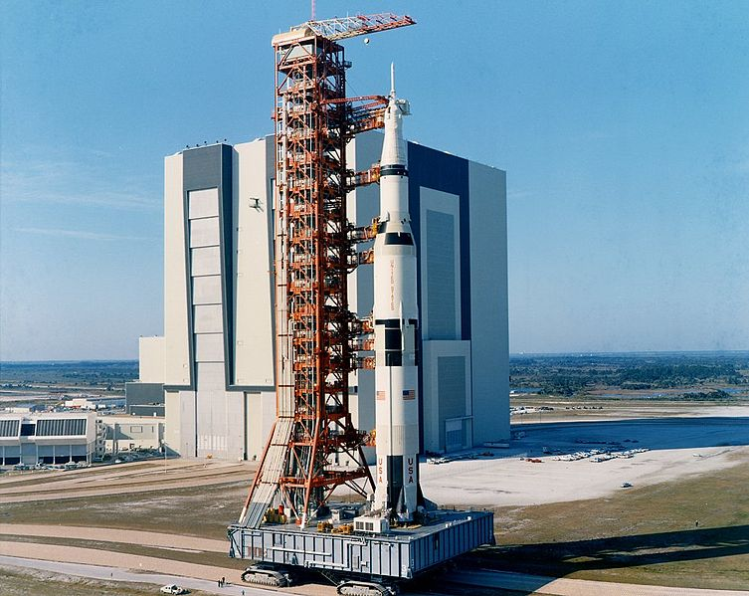
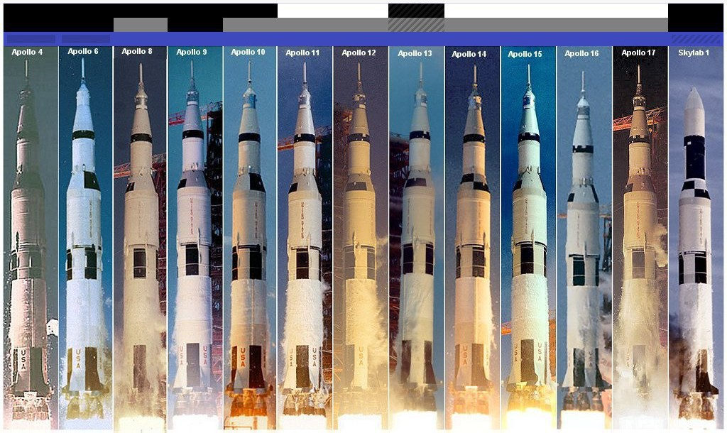

Slide 3

OPER 610 Lesson 19 Interior Point Methods 5: Revisiting Farka’s Lemma & the Method of Feasible Directions
Zoutendijk, 1929 – 2005
Notes:
Guus Zoutendijk (zoo-tin-dike)

Slide 4
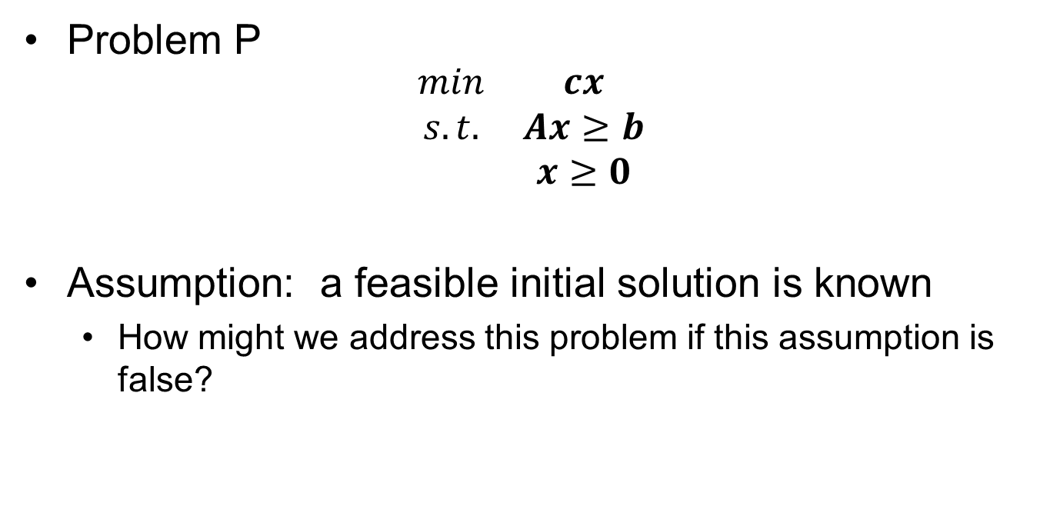
Basic Problem & Assumptions
Problem P
$$\begin{matrix}min & cx \\ s.t. & Ax≥b \\ & x≥0\end{matrix}$$
Assumption: a feasible initial solution is known
How might we address this problem if this assumption is false?

Slide 5




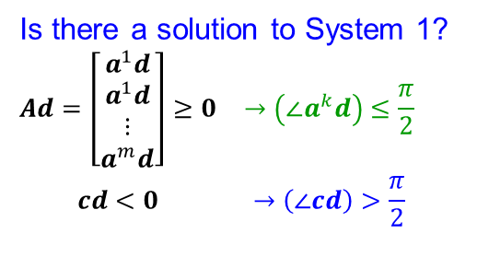
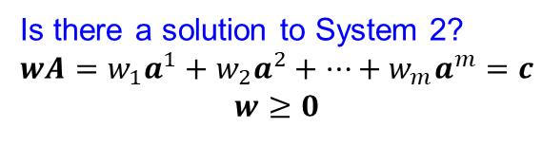







Farka’s Lemma (Either $x$ is optimal or $∃$ improving, feasible $d$)
Is there a solution to System 1?
$$\begin{matrix}Ad=\left[\begin{aligned}a^{1}d \\ a^{1}d \\ ⋮ \\ a^{m}d\end{aligned}\right]≥0 & →\left(∠a^{k}d\right)≤\frac{π}{2} \\ cd<0 & →\left(∠cd\right)>\frac{π}{2}\end{matrix}$$
Is there a solution to System 2?
$$\begin{matrix}wA=w_{1}a^{1}+w_{2}a^{2}+…+w_{m}a^{m}=c \\ w≥0\end{matrix}$$
$$a^{1}$$
$$a^{1}$$
$$c$$
$$a^{m}$$
$$a^{m}$$
$$a^{2}$$
$$a^{2}$$
$$a^{2}$$
$$a^{2}$$
$$c$$
YES
YES

Slide 6
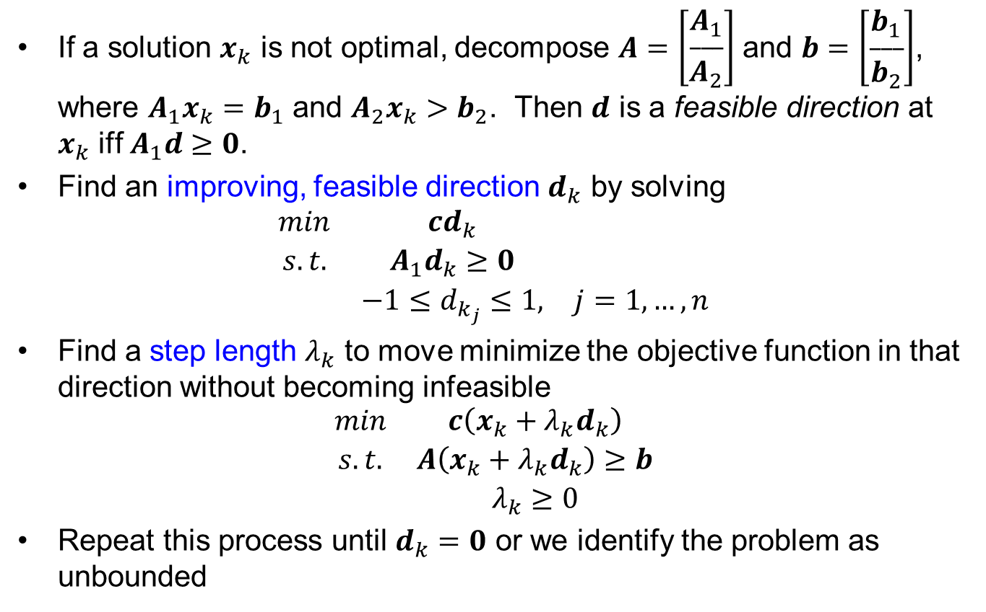

MOFD – Implementation #1 (at an iteration $k$)
If a solution $x_{k}$ is not optimal, decompose $A=\left[\begin{aligned}A_{1} \\ \begin{aligned}___ \\ A_{2}\end{aligned}\end{aligned}\right]$ and $b=\left[\begin{aligned}b_{1} \\ \begin{aligned}___ \\ b_{2}\end{aligned}\end{aligned}\right]$, where $A_{1}x_{k}=b_{1}$ and $A_{2}x_{k}>b_{2}$. Then $d$ is a feasible direction at $x_{k}$ iff $A_{1}d≥0$.
Find an improving, feasible direction $d_{k}$ by solving
$$\begin{matrix}min & cd_{k} & \\ s.t. & A_{1}d_{k}≥0 & \\ & −1≤d_{k_{j}}≤1, & j=1,…,n\end{matrix}$$
Find a step length $λ_{k}$ to move minimize the objective function in that direction without becoming infeasible
$$\begin{matrix}min & c\left(x_{k}+λ_{k}d_{k}\right) \\ s.t. & A\left(x_{k}+λ_{k}d_{k}\right)≥b \\ & λ_{k}≥0\end{matrix}$$
Repeat this process until $d_{k}=0$ or we identify the problem as unbounded

Slide 7
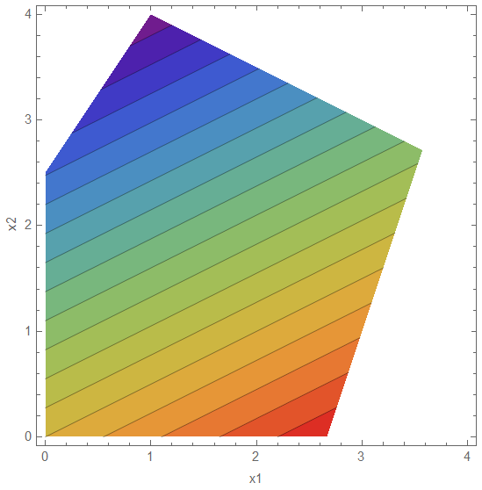


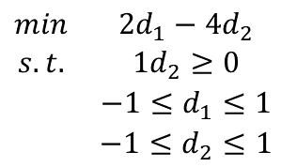
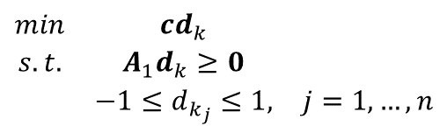
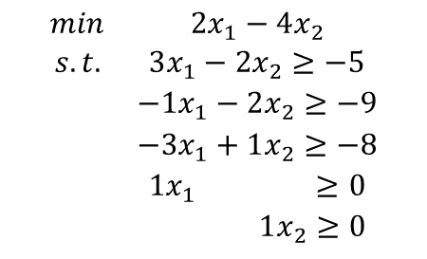



MOFD Example: Implementation #1 Iteration #1 – Find $dk$
$$\begin{matrix}min & 2x_{1}−4x_{2} \\ s.t. & 3x_{1}−2x_{2}≥−5 \\ & −1x_{1}−2x_{2}≥−9 \\ & −3x_{1}+1x_{2}≥−8 \\ & 1x_{1} ≥0 \\ & 1x_{2}≥0\end{matrix}$$
$$\begin{matrix}min & cd_{k} & \\ s.t. & A_{1}d_{k}≥0 & \\ & −1≤d_{k_{j}}≤1, & j=1,…,n\end{matrix}$$
$$\begin{matrix}min & 2d_{1}−4d_{2} \\ s.t. & 1d_{2}≥0 \\ & −1≤d_{1}≤1 \\ & −1≤d_{2}≤1\end{matrix}$$
$$d_{1}$$
$$x_{1}$$
$$x_{1}=\left[\begin{aligned}2 \\ 0\end{aligned}\right]$$
$$d_{1}=\left[\begin{aligned}−1 \\ 1\end{aligned}\right]$$

Slide 8



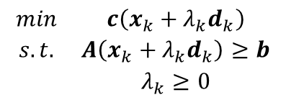
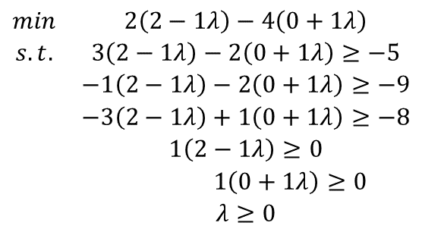



MOFD Example: Implementation #1 Iteration #1 – Find $λk$
$$\begin{matrix}min & c\left(x_{k}+λ_{k}d_{k}\right) \\ s.t. & A\left(x_{k}+λ_{k}d_{k}\right)≥b \\ & λ_{k}≥0\end{matrix}$$
$$\begin{matrix}min & 2\left(2−1λ\right)−4\left(0+1λ\right) \\ s.t. & 3\left(2−1λ\right)−2\left(0+1λ\right)≥−5 \\ & −1\left(2−1λ\right)−2\left(0+1λ\right)≥−9 \\ & −3\left(2−1λ\right)+1\left(0+1λ\right)≥−8 \\ & 1\left(2−1λ\right)≥0 \\ & 1\left(0+1λ\right)≥0 \\ & λ≥0\end{matrix}$$
$$x_{2}$$
$$d_{1}$$
$$λ_{1}=2$$
$$x_{1}$$
$$x_{2}=x_{1}+λ_{1}d_{1}=\left[\begin{aligned}2 \\ 0\end{aligned}\right]+2\left[\begin{aligned}−1 \\ 1\end{aligned}\right]=\left[\begin{aligned}0 \\ 2\end{aligned}\right]$$
$$x_{1}=\left[\begin{aligned}2 \\ 0\end{aligned}\right]$$

Slide 9






MOFD Example: Implementation #1 Iteration #2 – Find $dk$
$$\begin{matrix}min & 2x_{1}−4x_{2} \\ s.t. & 3x_{1}−2x_{2}≥−5 \\ & −1x_{1}−2x_{2}≥−9 \\ & −3x_{1}+1x_{2}≥−8 \\ & 1x_{1} ≥0 \\ & 1x_{2}≥0\end{matrix}$$
$$d_{2}$$
$$\begin{matrix}min & cd_{k} & \\ s.t. & A_{1}d_{k}≥0 & \\ & −1≤d_{k_{j}}≤1, & j=1,…,n\end{matrix}$$
$$x_{2}$$
$$\begin{matrix}min & 2d_{1}−4d_{2} \\ s.t. & 1d_{1}≥0 \\ & −1≤d_{1}≤1 \\ & −1≤d_{2}≤1\end{matrix}$$
$$d_{1}$$
$$x_{1}$$
$$x_{1}=\left[\begin{aligned}2 \\ 0\end{aligned}\right]$$
$$d_{2}=\left[\begin{aligned}0 \\ 1\end{aligned}\right]$$

Slide 10



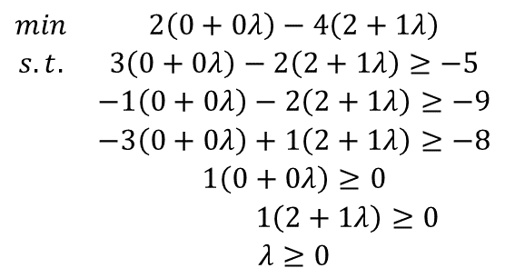

MOFD Example: Implementation #1 Iteration #2 – Find $λk$
$$\begin{matrix}min & c\left(x_{k}+λ_{k}d_{k}\right) \\ s.t. & A\left(x_{k}+λ_{k}d_{k}\right)≥b \\ & λ_{k}≥0\end{matrix}$$
$$\begin{matrix}min & 2\left(0+0λ\right)−4\left(2+1λ\right) \\ s.t. & 3\left(0+0λ\right)−2\left(2+1λ\right)≥−5 \\ & −1\left(0+0λ\right)−2\left(2+1λ\right)≥−9 \\ & −3\left(0+0λ\right)+1\left(2+1λ\right)≥−8 \\ & 1\left(0+0λ\right)≥0 \\ & 1\left(2+1λ\right)≥0 \\ & λ≥0\end{matrix}$$
$$d_{2}$$
$$x_{3}$$
$$x_{2}$$
$$d_{1}$$
$$λ_{2}=0.5$$
$$x_{1}$$
$$x_{3}=x_{2}+λ_{2}d_{2}=\left[\begin{aligned}0 \\ 2\end{aligned}\right]+0.5\left[\begin{aligned}0 \\ 1\end{aligned}\right]=\left[\begin{aligned}0 \\ 2.5\end{aligned}\right]$$
$$x_{1}=\left[\begin{aligned}2 \\ 0\end{aligned}\right]$$

Slide 11



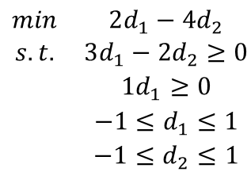

MOFD Example: Implementation #1 Iteration #3 – Find $dk$
$$\begin{matrix}min & 2x_{1}−4x_{2} \\ s.t. & 3x_{1}−2x_{2}≥−5 \\ & −1x_{1}−2x_{2}≥−9 \\ & −3x_{1}+1x_{2}≥−8 \\ & 1x_{1} ≥0 \\ & 1x_{2}≥0\end{matrix}$$
$$d_{3}$$
$$d_{2}$$
$$x_{3}$$
$$\begin{matrix}min & cd_{k} & \\ s.t. & A_{1}d_{k}≥0 & \\ & −1≤d_{k_{j}}≤1, & j=1,…,n\end{matrix}$$
$$x_{2}$$
$$\begin{matrix}min & 2d_{1}−4d_{2} \\ s.t. & 3d_{1}−2d_{2}≥0 \\ & 1d_{1}≥0 \\ & −1≤d_{1}≤1 \\ & −1≤d_{2}≤1\end{matrix}$$
$$d_{1}$$
$$x_{1}$$
$$x_{1}=\left[\begin{aligned}2 \\ 0\end{aligned}\right]$$
$$d_{3}=\left[\begin{aligned}0.6\overline{6} \\ 1\end{aligned}\right]$$

Slide 12



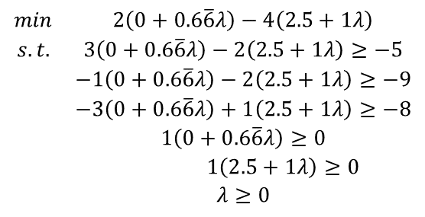

MOFD Example: Implementation #1 Iteration #3 – Find $λk$
$$x_{4}$$
$$\begin{matrix}min & c\left(x_{k}+λ_{k}d_{k}\right) \\ s.t. & A\left(x_{k}+λ_{k}d_{k}\right)≥b \\ & λ_{k}≥0\end{matrix}$$
$$d_{3}$$
$$d_{2}$$
$$\begin{matrix}min & 2\left(0+0.6\overline{6}λ\right)−4\left(2.5+1λ\right) \\ s.t. & 3\left(0+0.6\overline{6}λ\right)−2\left(2.5+1λ\right)≥−5 \\ & −1\left(0+0.6\overline{6}λ\right)−2\left(2.5+1λ\right)≥−9 \\ & −3\left(0+0.6\overline{6}λ\right)+1\left(2.5+1λ\right)≥−8 \\ & 1\left(0+0.6\overline{6}λ\right)≥0 \\ & 1\left(2.5+1λ\right)≥0 \\ & λ≥0\end{matrix}$$
$$x_{3}$$
$$x_{2}$$
$$d_{1}$$
$$λ_{3}=1.5$$
$$x_{1}$$
$$x_{4}=x_{3}+λ_{3}d_{3}=\left[\begin{aligned}0 \\ 2.5\end{aligned}\right]+1.5\left[\begin{aligned}0.6\overline{6} \\ 1\end{aligned}\right]=\left[\begin{aligned}1 \\ 4\end{aligned}\right]$$
$$x_{1}=\left[\begin{aligned}2 \\ 0\end{aligned}\right]$$

Slide 13

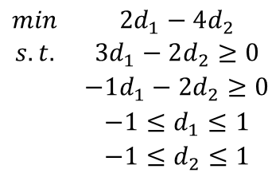

MOFD Example: Implementation #1 Iteration #4 – Find $dk$
$$\begin{matrix}min & 2x_{1}−4x_{2} \\ s.t. & 3x_{1}−2x_{2}≥−5 \\ & −1x_{1}−2x_{2}≥−9 \\ & −3x_{1}+1x_{2}≥−8 \\ & 1x_{1} ≥0 \\ & 1x_{2}≥0\end{matrix}$$
$$x_{4}$$
$$d_{3}$$
$$d_{2}$$
$$x_{3}$$
$$\begin{matrix}min & cd_{k} & \\ s.t. & A_{1}d_{k}≥0 & \\ & −1≤d_{k_{j}}≤1, & j=1,…,n\end{matrix}$$
$$x_{2}$$
$$\begin{matrix}min & 2d_{1}−4d_{2} \\ s.t. & 3d_{1}−2d_{2}≥0 \\ & −1d_{1}−2d_{2}≥0 \\ & −1≤d_{1}≤1 \\ & −1≤d_{2}≤1\end{matrix}$$
$$d_{1}$$
$$x_{1}$$
$$x_{1}=\left[\begin{aligned}2 \\ 0\end{aligned}\right]$$
$$d_{4}=\left[\begin{aligned}0 \\ 0\end{aligned}\right]$$
Terminate the algorithm!

Slide 14
$$x_{4}$$
$$d_{3}$$
$$d_{2}$$
$$x_{3}$$
$$x_{2}$$
$$d_{1}$$
$$x_{1}$$
$$x_{1}=\left[\begin{aligned}2 \\ 0\end{aligned}\right]$$

Slide 15
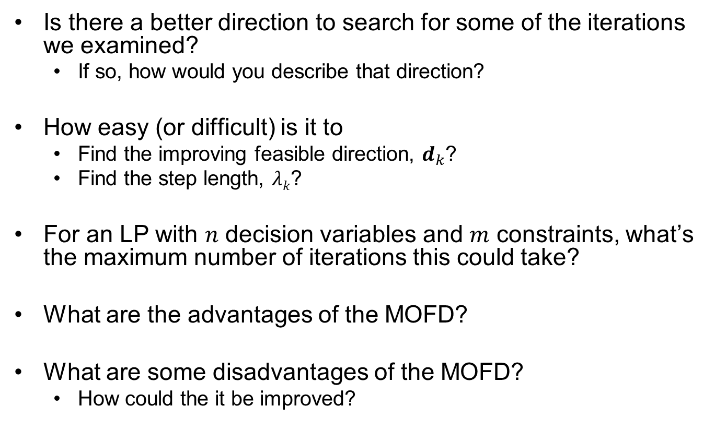
Discussion Questions
Is there a better direction to search for some of the iterations we examined?
If so, how would you describe that direction?
How easy (or difficult) is it to
Find the improving feasible direction, $d_{k}$?
Find the step length, $λk$?
For an LP with $n$ decision variables and $m$ constraints, what’s the maximum number of iterations this could take?
What are the advantages of the MOFD?
What are some disadvantages of the MOFD?
How could the it be improved?

Slide 16
MOFD – Implementation #1 (at an iteration $k$)
(same as previous slide shown)
If a solution $x_{k}$ is not optimal, decompose $A=\left[\begin{aligned}A_{1} \\ \begin{aligned}___ \\ A_{2}\end{aligned}\end{aligned}\right]$ and $b=\left[\begin{aligned}b_{1} \\ \begin{aligned}___ \\ b_{2}\end{aligned}\end{aligned}\right]$, where $A_{1}x_{k}=b_{1}$ and $A_{2}x_{k}>b_{2}$. Then $d$ is a feasible direction at $x_{k}$ iff $A_{1}d≥0$.
Find an improving, feasible direction $d_{k}$ by solving
$$\begin{matrix}min & cd_{k} & \\ s.t. & A_{1}d_{k}≥0 & \\ & −1≤d_{k_{j}}≤1, & j=1,…,n\end{matrix}$$
Find a step length $λ_{k}$ to move minimize the objective function in that direction without becoming infeasible
$$\begin{matrix}min & c\left(x_{k}+λ_{k}d_{k}\right) \\ s.t. & A\left(x_{k}+λ_{k}d_{k}\right)≥b \\ & λ_{k}≥0\end{matrix}$$
Repeat this process until $d_{k}=0$ or we identify the problem as unbounded

Slide 17


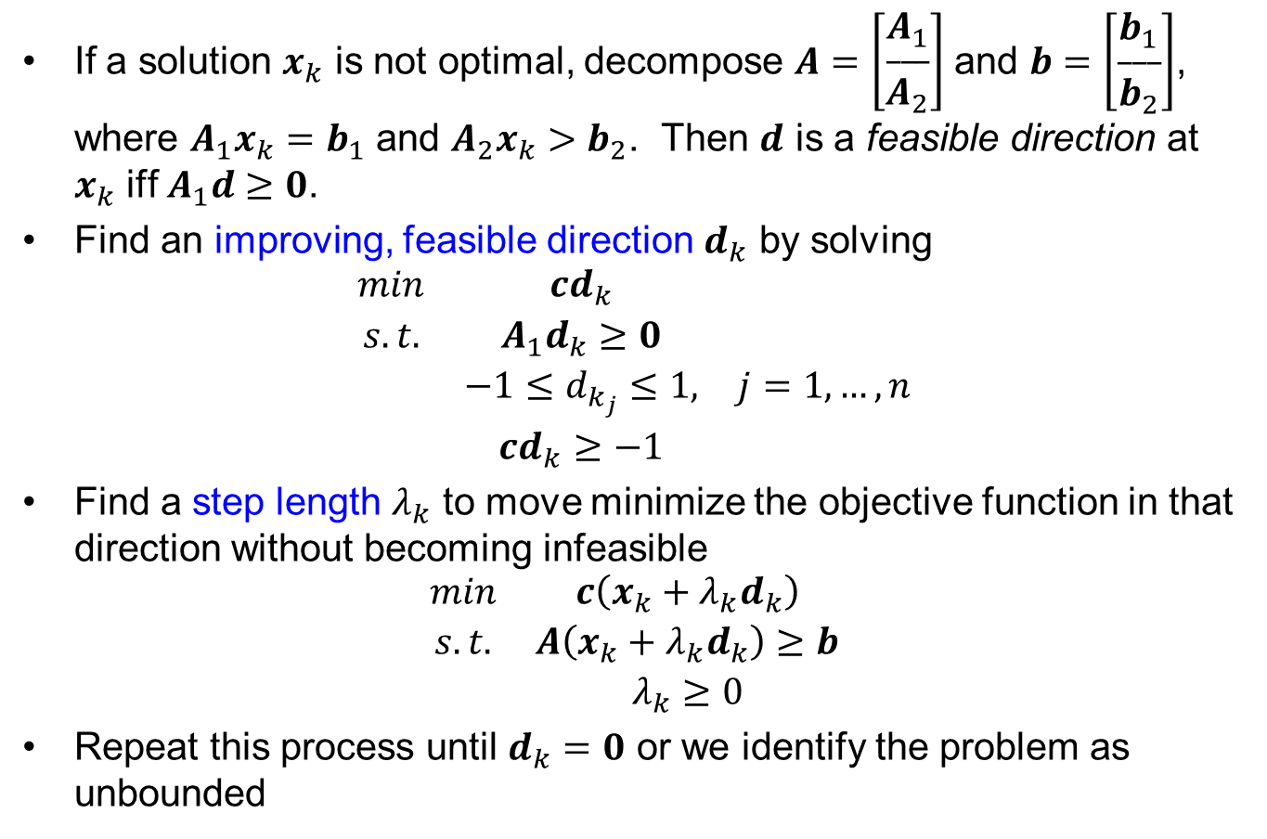
MOFD – Implementation #2 (at an iteration $k$)
If a solution $x_{k}$ is not optimal, decompose $A=\left[\begin{aligned}A_{1} \\ \begin{aligned}___ \\ A_{2}\end{aligned}\end{aligned}\right]$ and $b=\left[\begin{aligned}b_{1} \\ \begin{aligned}___ \\ b_{2}\end{aligned}\end{aligned}\right]$, where $A_{1}x_{k}=b_{1}$ and $A_{2}x_{k}>b_{2}$. Then $d$ is a feasible direction at $x_{k}$ iff $A_{1}d≥0$.
Find an improving, feasible direction $d_{k}$ by solving
$$\begin{matrix}min & cd_{k} & \\ s.t. & A_{1}d_{k}≥0 & \\ & −1≤d_{k_{j}}≤1, & j=1,…,n \\ & cd_{k}≥−1 & \end{matrix}$$
Find a step length $λ_{k}$ to move minimize the objective function in that direction without becoming infeasible
$$\begin{matrix}min & c\left(x_{k}+λ_{k}d_{k}\right) \\ s.t. & A\left(x_{k}+λ_{k}d_{k}\right)≥b \\ & λ_{k}≥0\end{matrix}$$
Repeat this process until $d_{k}=0$ or we identify the problem as unbounded
How will this change affect the quality of $d_{k}$?
How will it affect the efficiency of finding $d_{k}$?

Slide 18
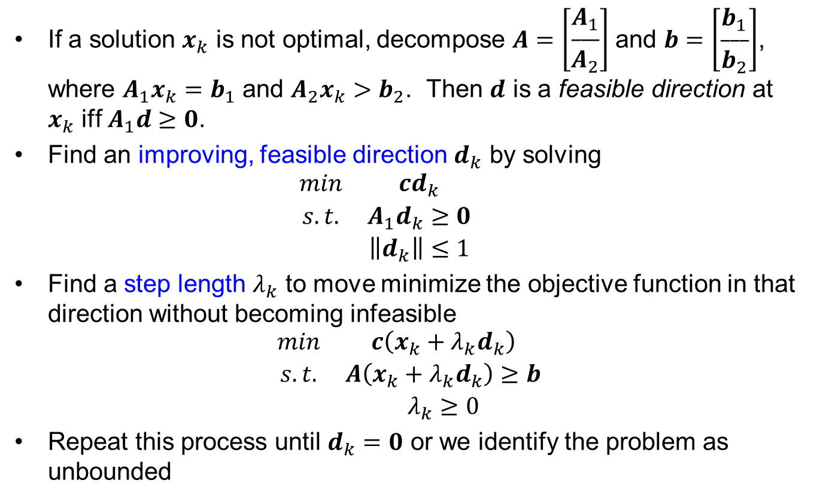


MOFD – Implementation #3 (at an iteration $k$)
If a solution $x_{k}$ is not optimal, decompose $A=\left[\begin{aligned}A_{1} \\ \begin{aligned}___ \\ A_{2}\end{aligned}\end{aligned}\right]$ and $b=\left[\begin{aligned}b_{1} \\ \begin{aligned}___ \\ b_{2}\end{aligned}\end{aligned}\right]$, where $A_{1}x_{k}=b_{1}$ and $A_{2}x_{k}>b_{2}$. Then $d$ is a feasible direction at $x_{k}$ iff $A_{1}d≥0$.
Find an improving, feasible direction $d_{k}$ by solving
$$\begin{matrix}min & cd_{k} & \\ s.t. & A_{1}d_{k}≥0 & \\ & \left\|d_{k}\right\|≤1 & \end{matrix}$$
Find a step length $λ_{k}$ to move minimize the objective function in that direction without becoming infeasible
$$\begin{matrix}min & c\left(x_{k}+λ_{k}d_{k}\right) \\ s.t. & A\left(x_{k}+λ_{k}d_{k}\right)≥b \\ & λ_{k}≥0\end{matrix}$$
Repeat this process until $d_{k}=0$ or we identify the problem as unbounded
How will this change affect the quality of $d_{k}$?
How will it affect the efficiency of finding $d_{k}$?

Slide 19
Questions & Discussion

Slide 20
For Next Class
Supplemental reading on Canvas page
Todd, M. J. (2002). The many facets of linear programming. Mathematical Programming, 91(3), 417-436.

